Slide 1

Practical 6
Product of Three Largest Distinct Elements Using Priority Queue

Slide 2

Lesson Plan
Subject/Course | Competitive Coding
Lesson Title | Product of Three Largest Distinct Elements Using Priority Queue
Lesson Objectives
Identify and extract the three largest unique elements from an array using a max-heap (priority queue).
Implement insertion, extraction, and duplicate handling for O(n log n) efficiency.
Compute products of top elements while ensuring distinctness to avoid errors in real-world data.
Apply priority queues to top-k problems, boosting speed in interviews and contests.

Slide 3
Problem Statement:
Write a Program for finding the Product of the three largest Distinct Elements. Use a Priority Queue to efficiently find and remove the largest elements.

Slide 4
Key Concepts & Prerequisites
A Priority Queue is a data structure where each element has a priority — the highest-priority element is served first.
It can be implemented as a Heap:
Min-Heap → smallest element at top
Max-Heap → largest element at top
Why use it here?
To find the 3 largest distinct elements, sorting takes O(n log n).
A Priority Queue can do it faster: O(n log k) for k = 3 → practically O(n).
Distinct Elements
We must ensure all elements are unique before finding the top 3. → Use a set to remove duplicates.

Slide 5
Key Concepts & Prerequisites
Prerequisites:
Arrays from basics;
Queues from Q4;
Understand heap property (parent > children).

Slide 6
Algorithm/Logic
High-Level Approach
Read array and n.
Push all elements to max-heap priority_queue.
Pop largest, add to result list; use set to skip if duplicate.
Repeat for 3 unique; if <3, return error.
Compute product of the three.

Slide 7
Algorithm/Logic
Detailed Algorithm
Input: An array arr of integers.
Remove duplicates using a set → ensures only distinct elements.
Create a Max-Heap:
Since Python’s heapq is a min-heap, insert negative values to simulate a max-heap.
Extract top 3 elements by popping the heap 3 times.Compute product of those 3 numbers.
Return / print the result.

Slide 8
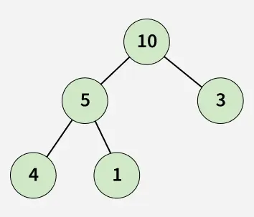
Visualization
Example Input: arr = [4, 7, 2, 7, 5, 9, 9]
Step 1: Remove duplicates → {2, 4, 5, 7, 9}
Step 3: Extract Top 3 → 9, 7, 5
Step 4: Product = 9 × 7 × 5 = 315
Step | Heap (max-heap view) | Extracted | Product
1 | [9, 7, 5, 4, 2] | 9 | 9
2 | [7, 4, 5, 2] | 7 | 63
3 | [5, 4, 2] | 5 | 315

Slide 9
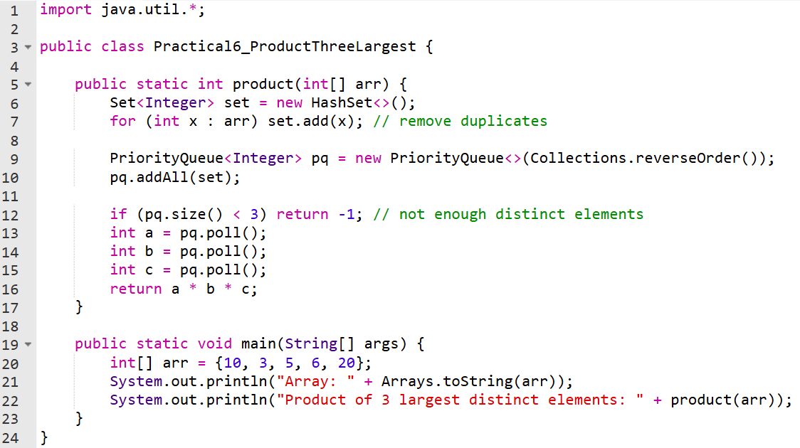
Code Implementation

Slide 11
Output :
Array: [10, 3, 5, 6, 20]
Product of 3 largest distinct elements: 1200

Slide 12
Complexity Analysis
Aspect | Complexity | Why?
Time | O(n log n) | n inserts/pops at O(log n); Set ops O(log k) for k=3.
Space | O(n) | Heap stores all n; Set O(1) since k=3 fixed.

Slide 13
Variations & Competitive Tips
Easier Variation: No distinct check (just pop 3).
Harder: K largest (generalize to input k); Streaming input (no full array).
Competitive Angle: LeetCode #414: Third Largest; Codeforces "Top K" problems.
Optimization: For huge n, use partial_sort (O(n log k)) instead of full heap.

Slide 14
Practice Exercises
1️⃣ Third Maximum Number — LeetCode #414 🔗 https://leetcode.com/problems/third-maximum-number/ Concept: Finding the 3rd largest distinct element in an array. Why Practice: Directly mirrors the logic of selecting top 3 unique numbers.

Slide 15
Practice Exercises
2️⃣ Kth Largest Element in an Array — LeetCode #215 🔗 https://leetcode.com/problems/kth-largest-element-in-an-array/ Concept: Using a priority queue (heap) to find kth largest value efficiently. Why Practice: Strengthens heap operations and selection of maximum elements.

Slide 16
Practice Exercises
3️⃣ Maximum Product of Three Numbers — LeetCode #628 🔗 https://leetcode.com/problems/maximum-product-of-three-numbers/ Concept: Compute product of three largest (or smallest) numbers. Why Practice: Exactly applies the product-of-largest-elements logic efficiently.

Slide 17
Thanks

